Slide 1


TRAIN AND DEPLOY A MACHINE LEARNING MODEL IN AWS CLOUD

Slide 2

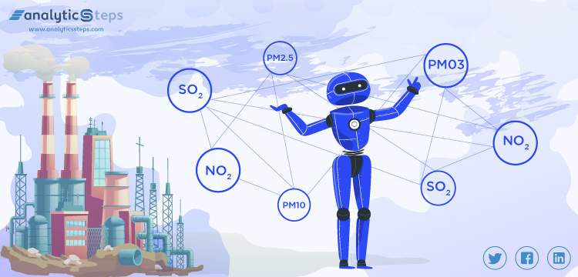
TEAM MEMBERS
Naga Srinivas.B
Sai Swetha.K
Manju.T
Kumar Rajesh.K
Training a Machine Learning Algorithm by using Machine Learning which claims a dataset thereby predicting the Air Quality. Machine Learning involves computational methods which learn from complex data to build various models for prediction, classification, and evaluation. The study attempts to build forecasting models capable of efficient pattern recognition and self-learning. And the trained algorithm is deployed in AWS cloud.
This project helps in analysing the Air Quality in coming days based on past data which can alert people to take necessary measures to cherish in healthy environment.

Slide 3

WORKING:
Our Project claims a multiple input data which describes the concentration of air molecules.
The Machine learning Algorithm is trained on the given dataset.
We identified the best convenient algorithm by trail and error method and fixed to KNN Regression.
Here out of given dataset 80% of the data is used for training and remaining 20% is used for testing.
Now, the trained algorithm is tested on 20% of the previously disparated 20% of the data.
The tested and predicted values are compared.
And then , the trained algorithm is deployed on the AWS cloud platform which supports the dynamic datasets.
Instead of restricting its use only to the personal computer the cloud platform enables access for everyone.

Slide 4

.
LIFE CYCLE
Identifying Problems of Air Pollution
Collection of data sets from time series
Applying Machine Learning
Splitting the datasets
Training the Machine Learning Algorithm
Obtaining the predicted values from algorithm
Uploading the trained algorithm in AWS cloud
Analysing the Air Quality Conditions and taking necessary measures

Slide 5

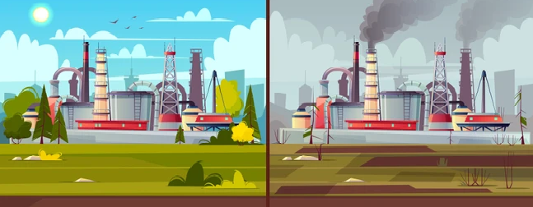
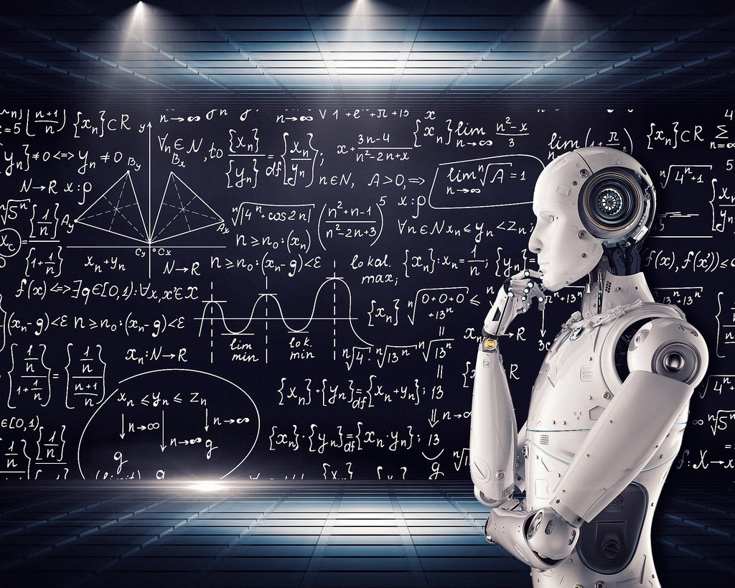

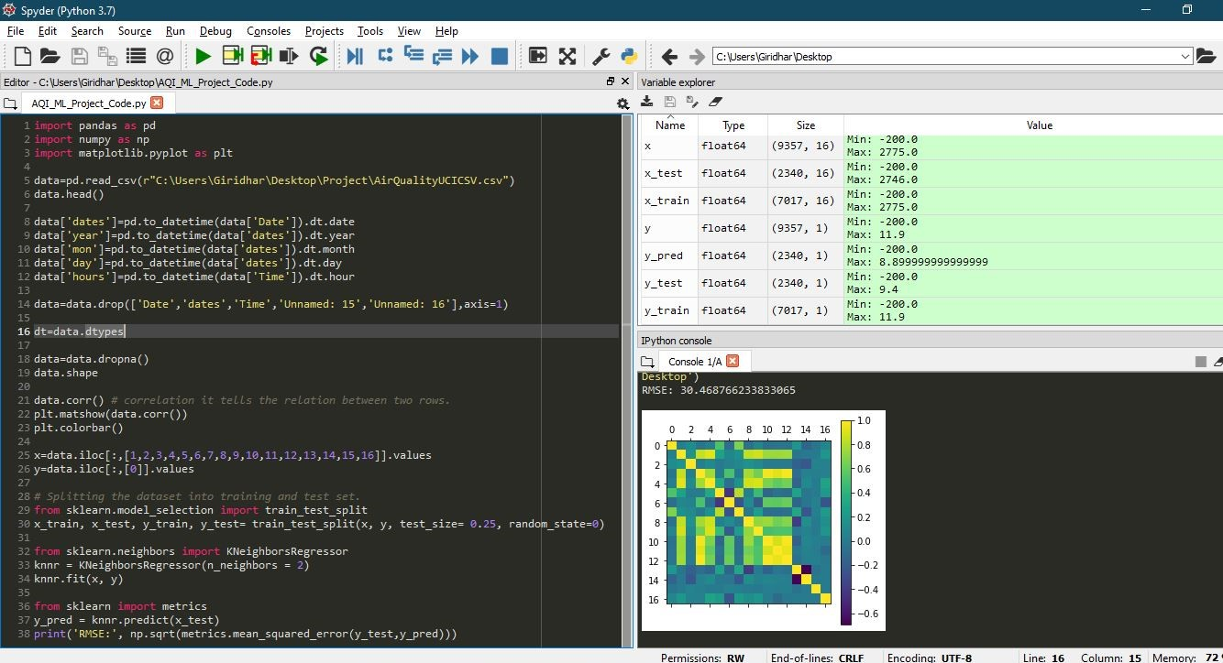
Data understanding and preparation
Modelling and Implementation

Slide 6

THANK YOU!
ANY QUERIES?...
Contact : kkumarrajesh333@gmail.com

